Slide 1
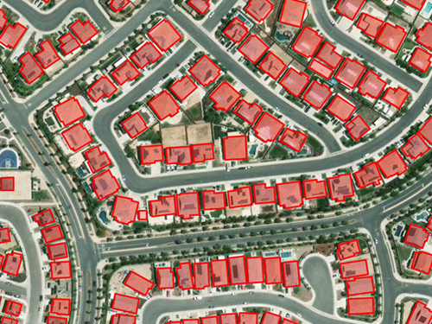
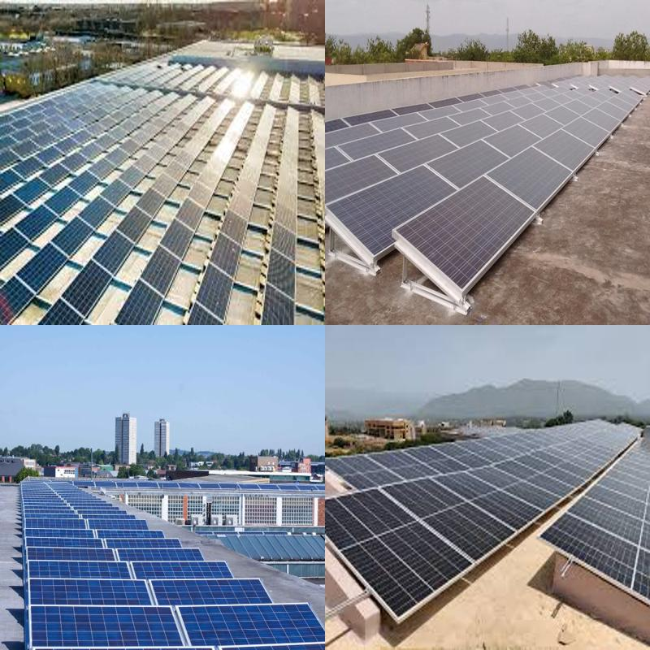

Optimizing Solar Energy Utilization: Rooftop Detection and
PV Potential Estimation with Deep Learning
Presented by
SAMPURNA SAHA
PRN: 24070146015
Semester- III; Dissertation Phase-I
M.Tech. in Geoinformatics (2024-2026)
Guided by
Dr. Sandipan Das
Assistant Professor
SYMBIOSIS INSTITUTE OF GEOINFORMATICS, SIU

Slide 2


INTRODUCTION
The accelerating global demand for energy, coupled with the environmental and socio-economic costs of fossil fuel dependence, has intensified the transition towards renewable energy alternatives.
Solar Photovoltaic (PV) Energy stands out as one of the most viable solutions due to its inexhaustible nature, decreasing installation costs and capacity to support decentralized power generation.
Rooftop Solar PV not only lowers transmission losses but also mitigates the risk of large-scale blackouts while directly contributing to the reduction of urban carbon footprints.
2

Slide 3
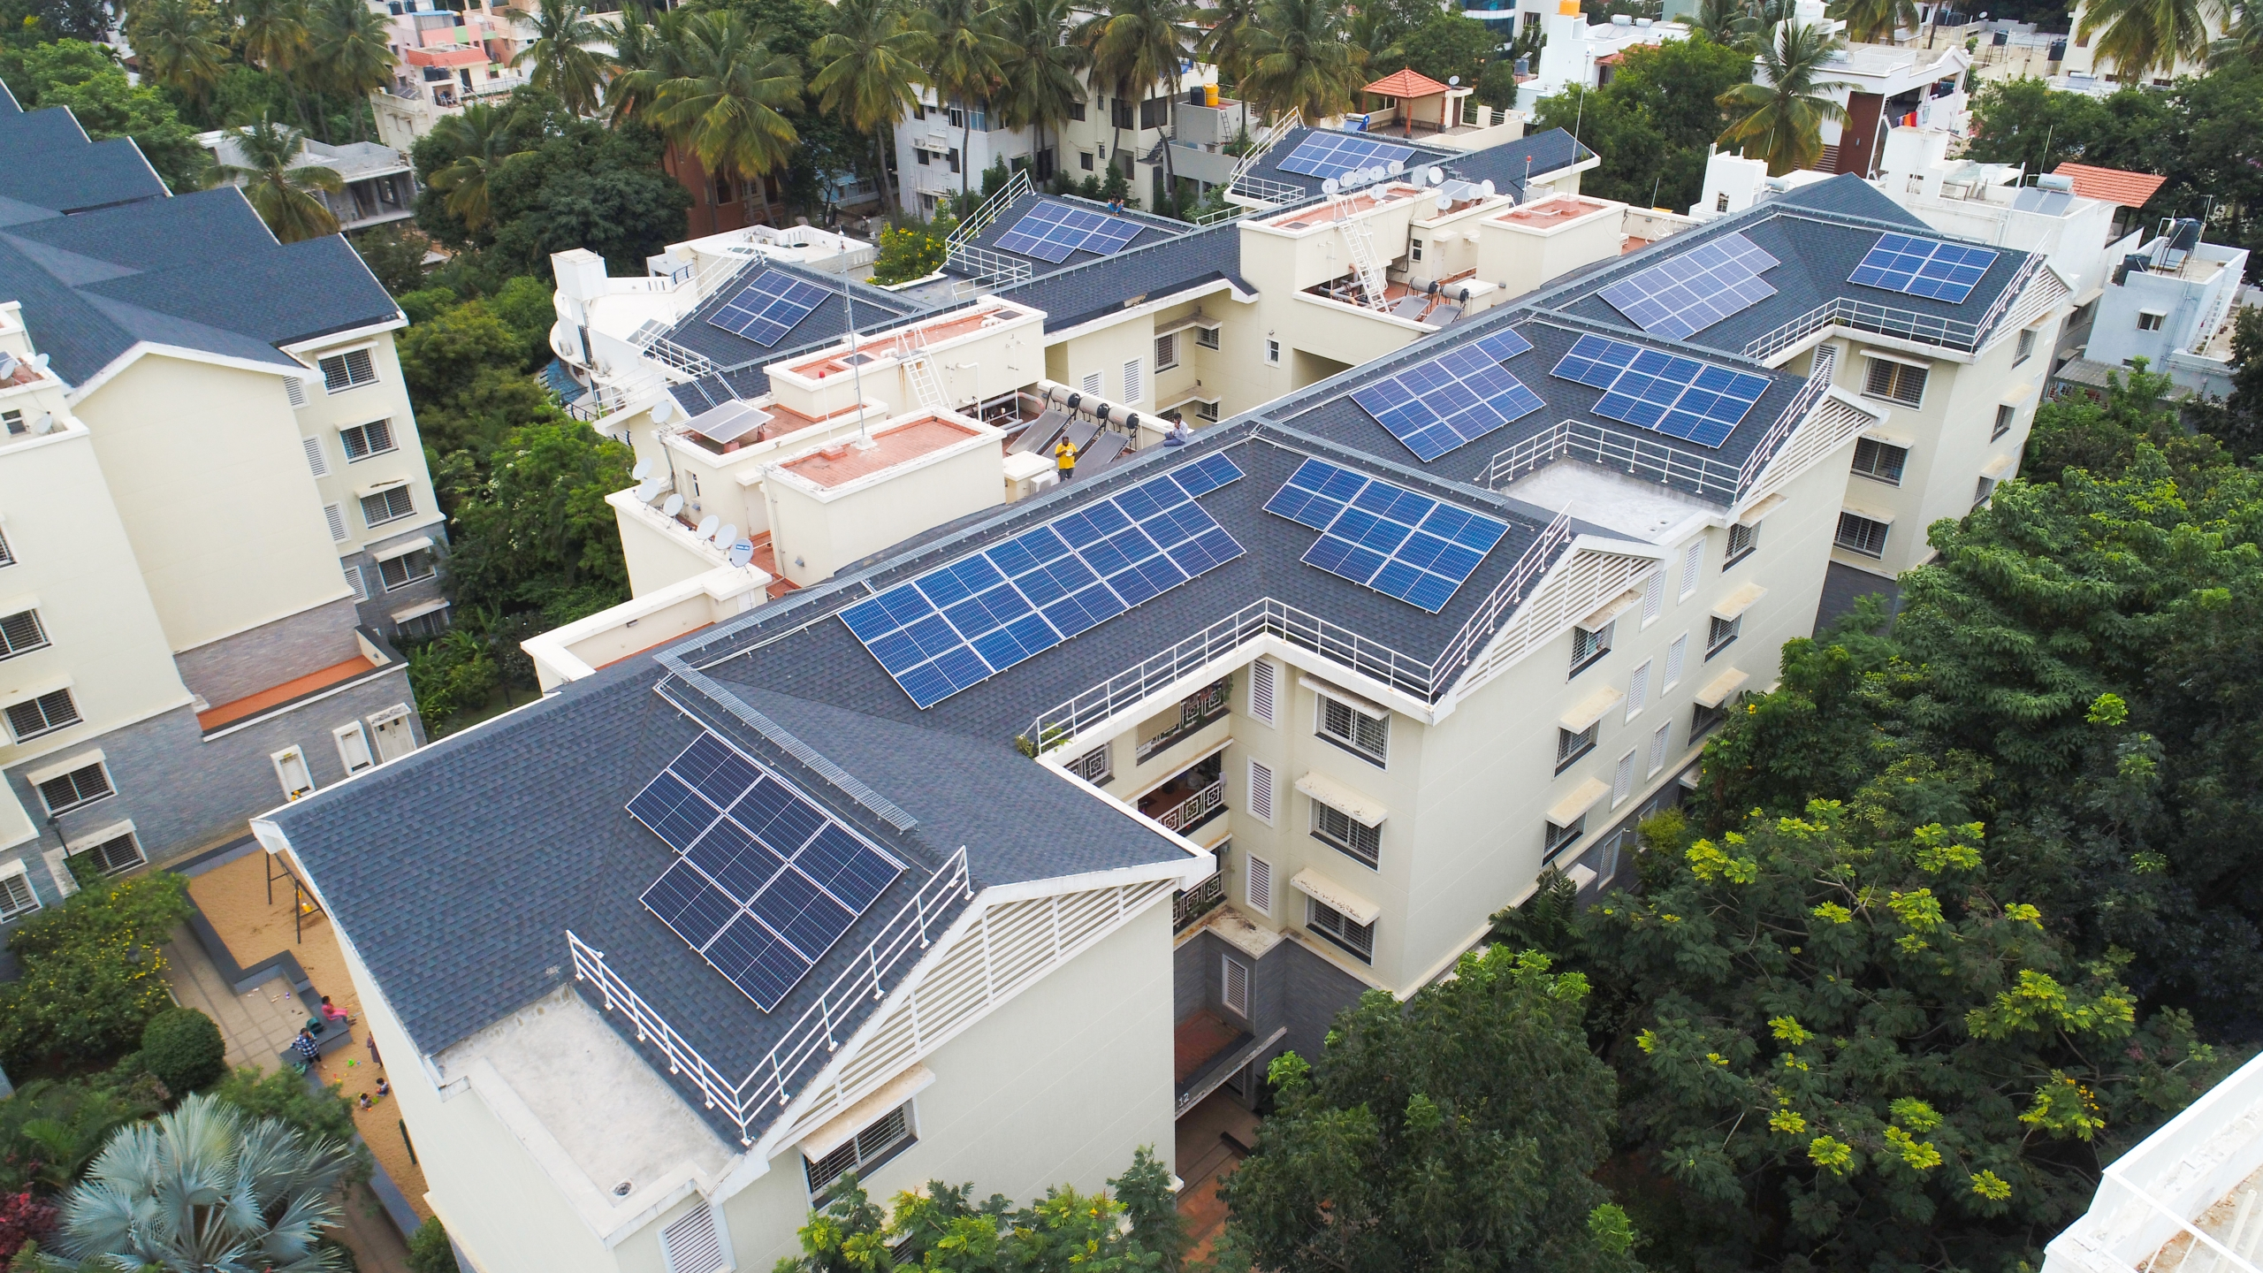
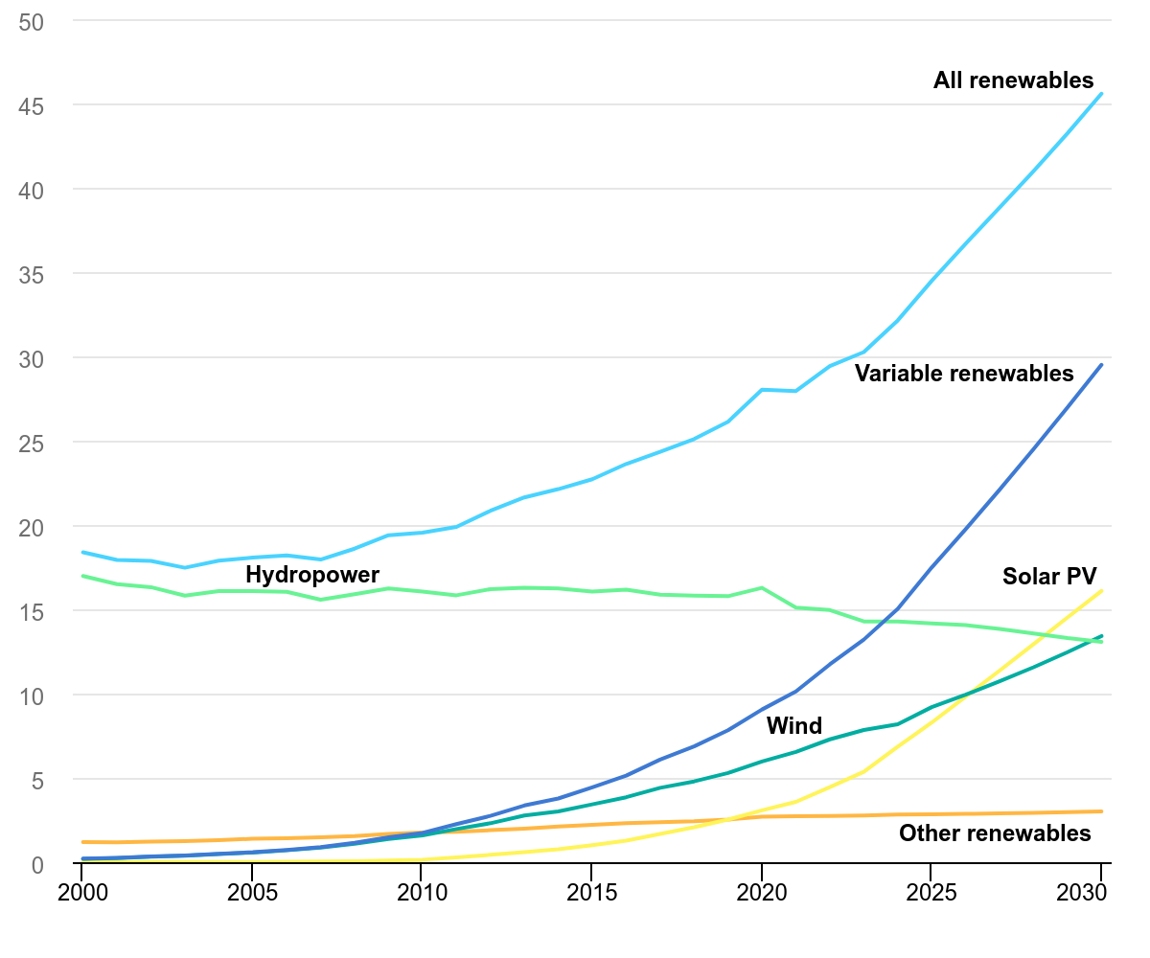
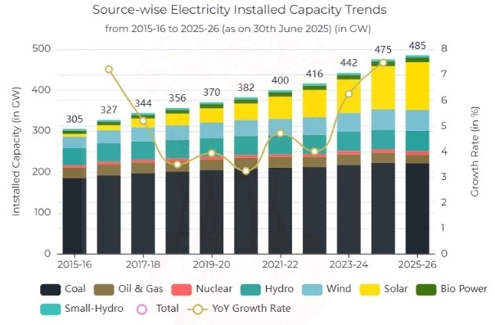
SIGNIFICANCE OF THE STUDY
(a)
Solar PV grew negligibly until 2010, then expanded with cost declines and policy support. Post-2020, it rises exponentially, projected to surpass 15% by 2030, overtaking hydropower and nearly matching wind, making it the fastest-growing renewable source.
(b)
India’s solar capacity grew from just 5 GW in 2015–16 to nearly 55 GW by 2021–22. By 2025–26, solar is projected at 120 GW, the single largest contributor to India’s 485 GW installed capacity, surpassing wind and hydropower.
3
Source: International Energy Agency (IEA) (a); Central Electricity Authority (CEA) & National Power Plan (NPP) (b)

Slide 4
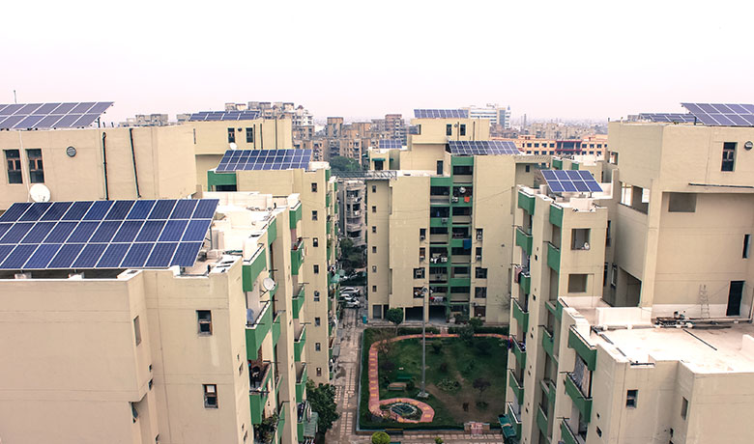





MOTIVATION: Aligning with SDG Goals
Rooftop solar integration curbs electricity emissions, advancing urgent climate action.
Driving sustainable growth with universal access to clean power.
Harnessing deep learning for sustainable urban energy systems.
Solar PV advances sustainable, adaptive, and energy-efficient cities.
4

Slide 5
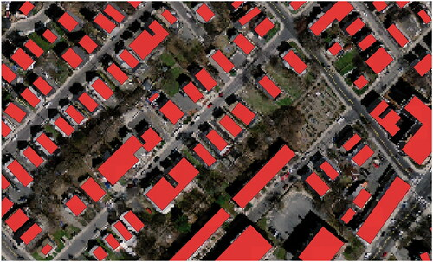
REVIEW OF LITERATURE
5

Slide 6
CONTINUED…
6

Slide 7
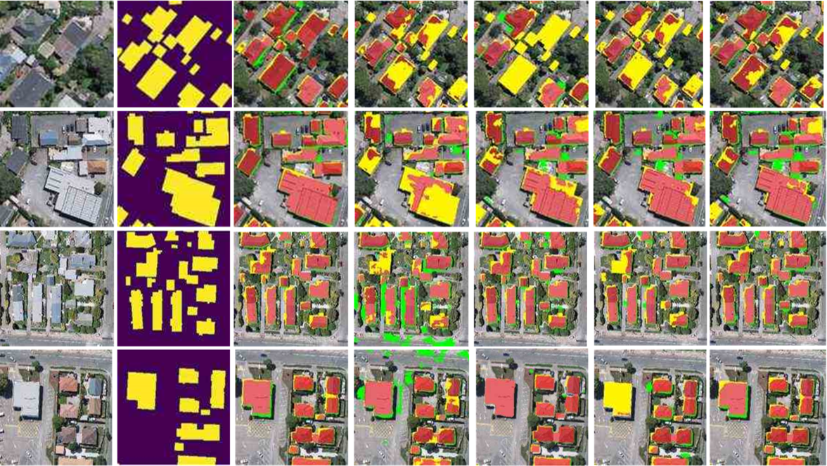

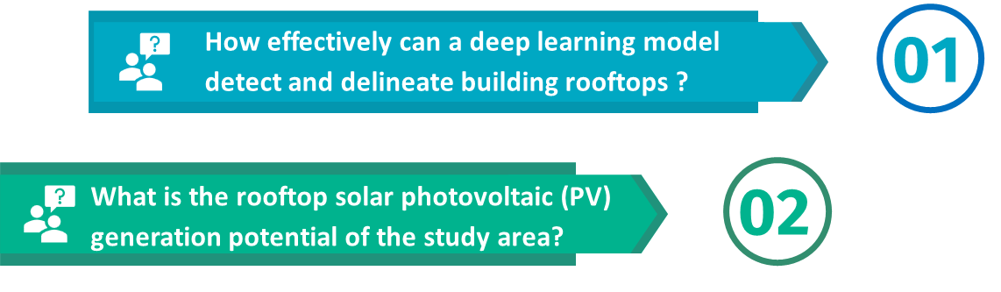
7

Slide 8
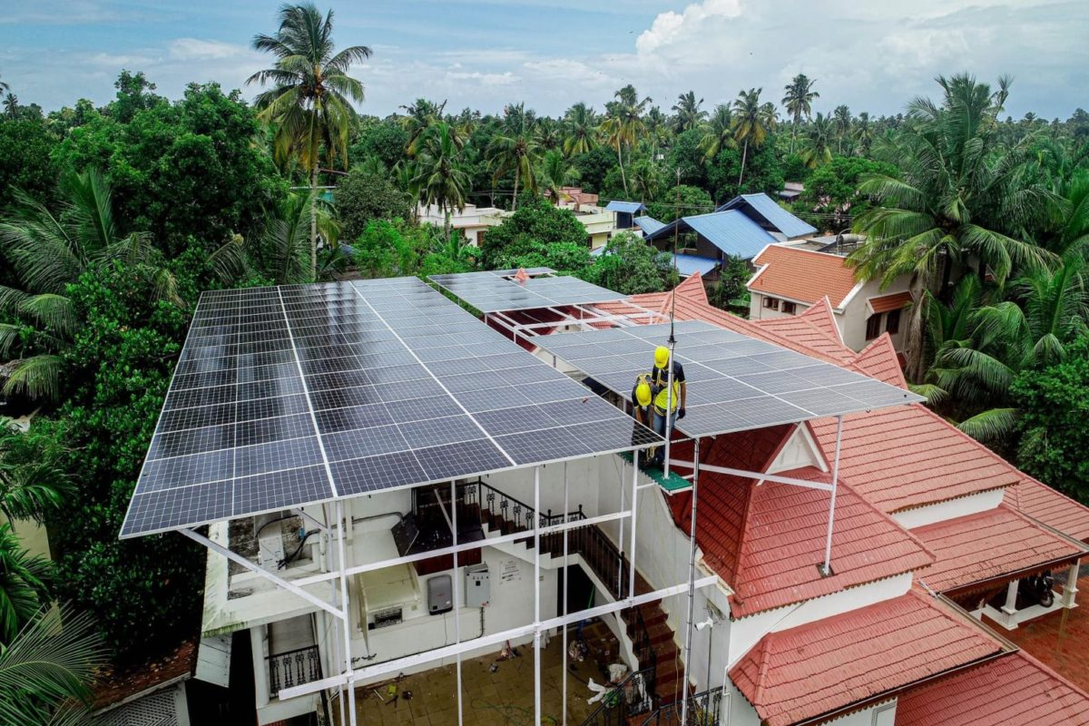


A
OBJECTIVES
To develop a deep-learning-based approach for automatic rooftop detection using the YOLOv8n-segmentation model.
This research aims to develop and implement a deep-learning-based framework for automatic rooftop detection and solar photovoltaic (PV) potential estimation, thereby advancing SDG 7 by promoting access to clean and affordable energy, and supporting SDG 11 by enabling sustainable energy planning in urban environments.
I
01
M
02
To estimate the rooftop solar photovoltaic (PV) potential.
S
8

Slide 9

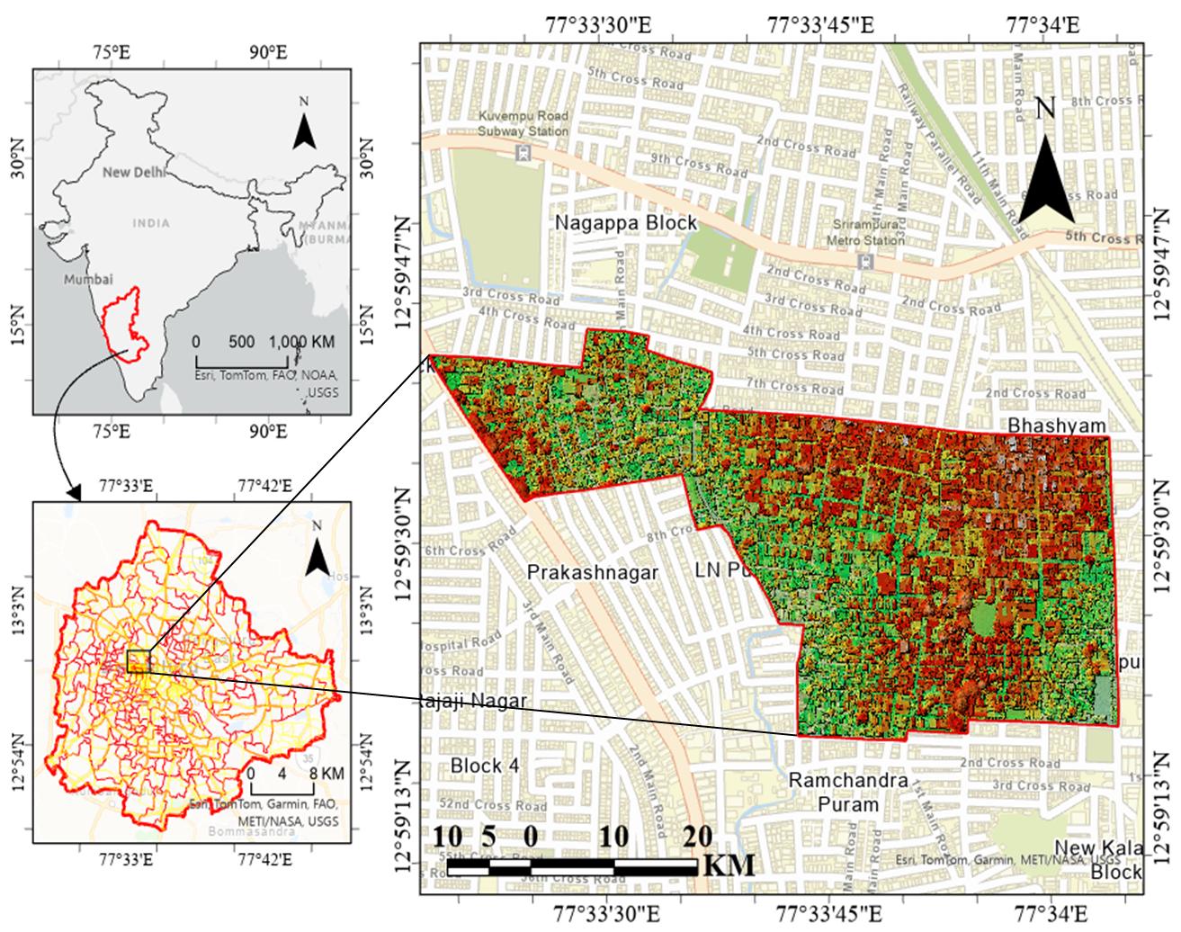
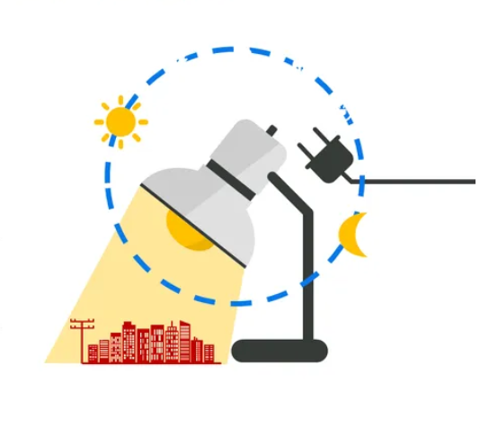
STUDY AREA
INDIA
BBMP WARD: 76
The study area is BBMP Ward 76, a densely built-up urban ward within Bengaluru.
The ward has mixed land use with diverse rooftop patterns.
A UAV survey generated a high-accuracy ortho-mosaic with 5 cm resolution, enabling precise rooftop and feature extraction.
The dataset contains three multispectral bands (RGB) suitable for deep learning–based building detection.
BENGALURU
9

Slide 10
DATASETS
DATA(S) | DESCRIPTION | SOURCES
Raster File of the Study Area | Processes from UAV Dataset | Centre for Study of Science, Technology and Policy (CSTEP) (https://cstep.in/)
DEM of the Study Area | Generate from the same Drone Data | ---
Hillshade map of the Study Area | Processed from the previously mentioned DEM Data | ---
Solar Insolation | NOAA Solar position calculator ISRO Solar Calculator | https://gml.noaa.gov/grad/solcalc/azel.html https://vedas.sac.gov.in/solar-calculator/
Solar Radiation | Copernicus Atmosphere Monitoring Services (CAMS) | https://atmosphere.copernicus.eu/
Tilt Angle of the Solar Panel | Depending on the latitude of the Study Area | ---
10

Slide 11
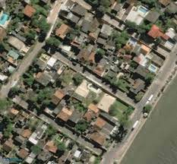
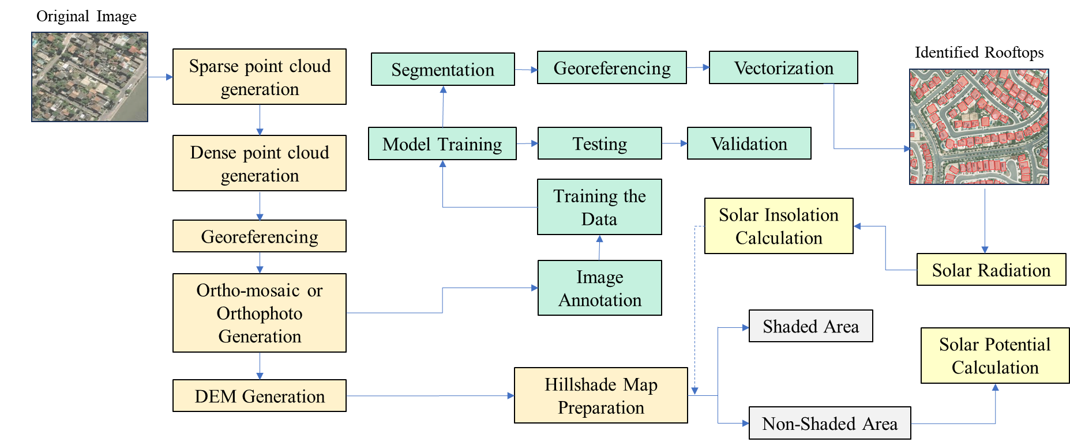
METHODOLOGY
11

Slide 12
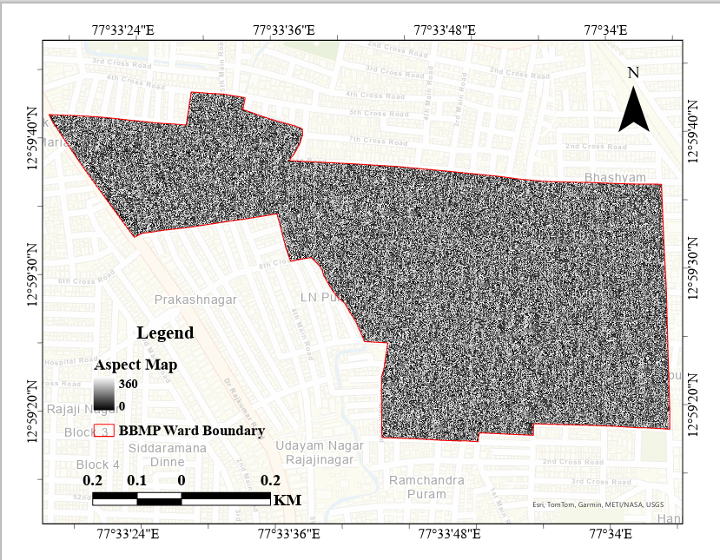
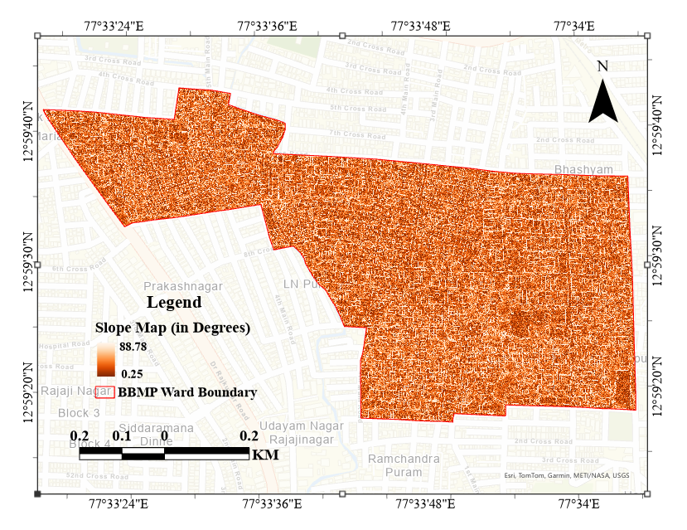
ASPECT
DATA PREPARATION
SLOPE
12

Slide 13
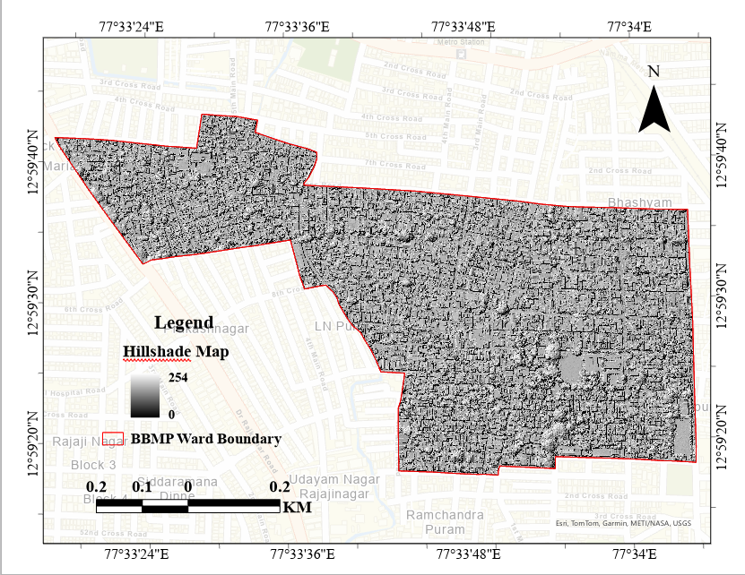
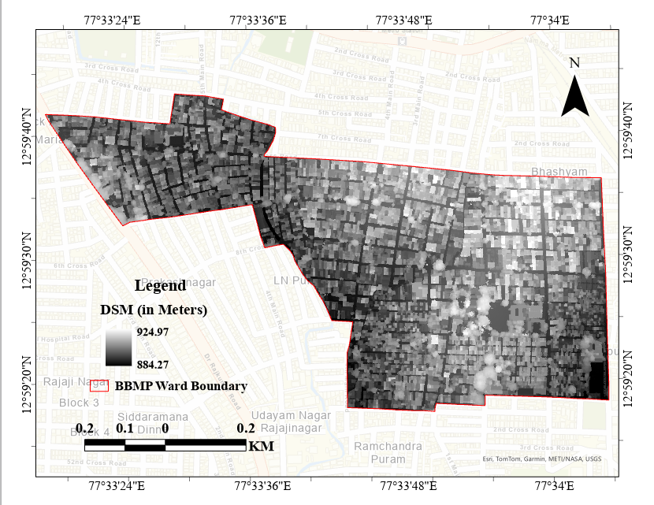
HILLSHADE
ELEVATION (DSM)
13

Slide 14
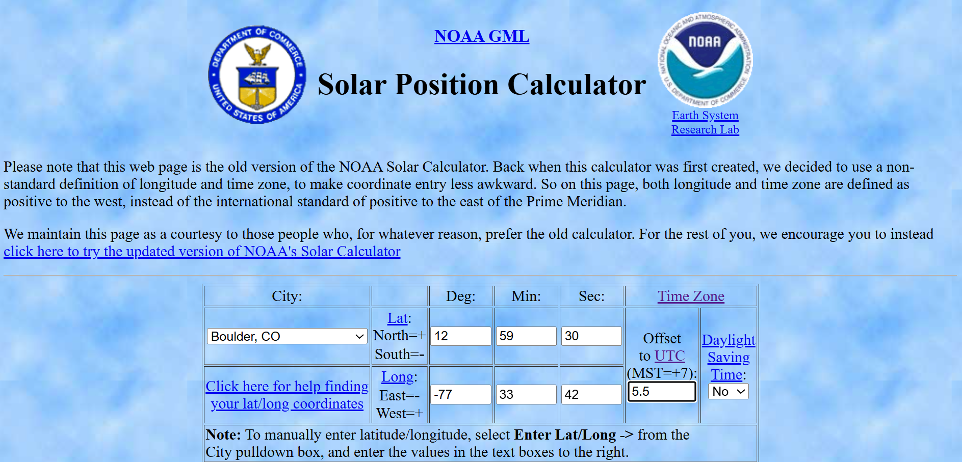
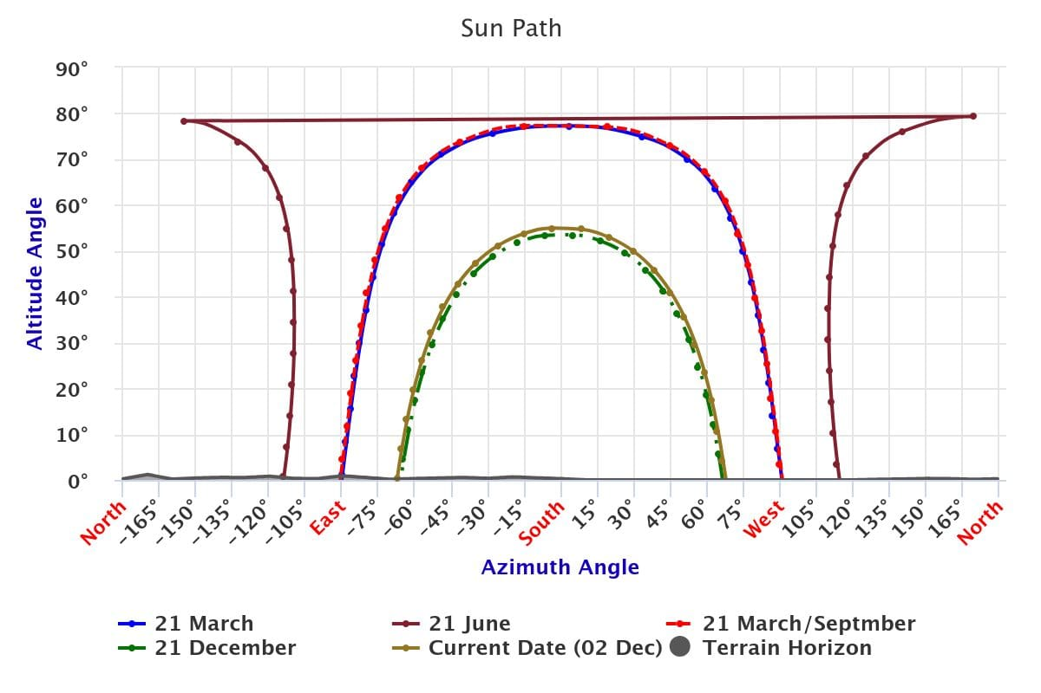
Accurate sun angle values for multiple dates were derived using the NOAA Solar Position Calculator, providing essential illumination parameters for precise rooftop and shadow interpretation.
The use of NOAA’s solar geometry data improved the reliability of feature detection and enhanced the overall analytical accuracy within the study area.
14

Slide 15
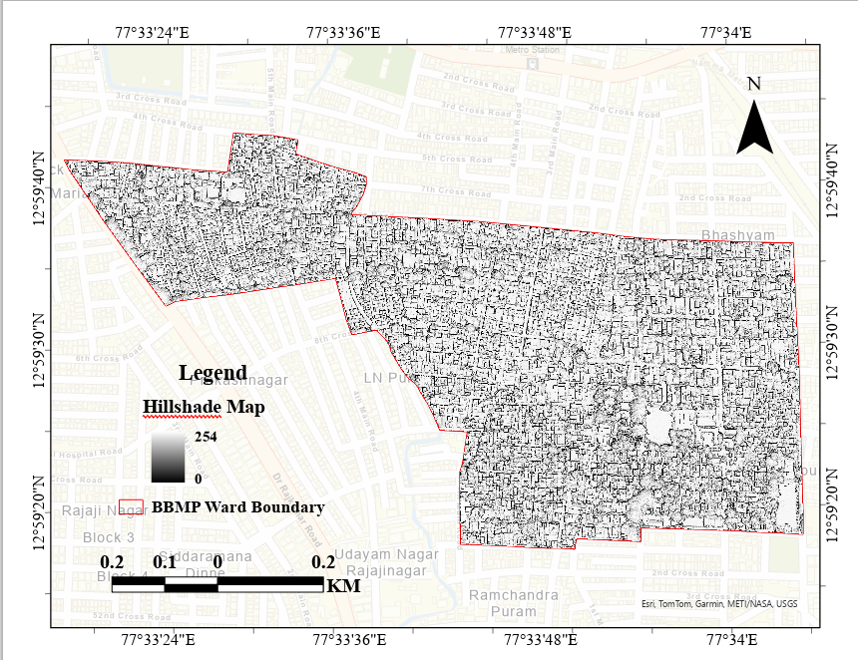
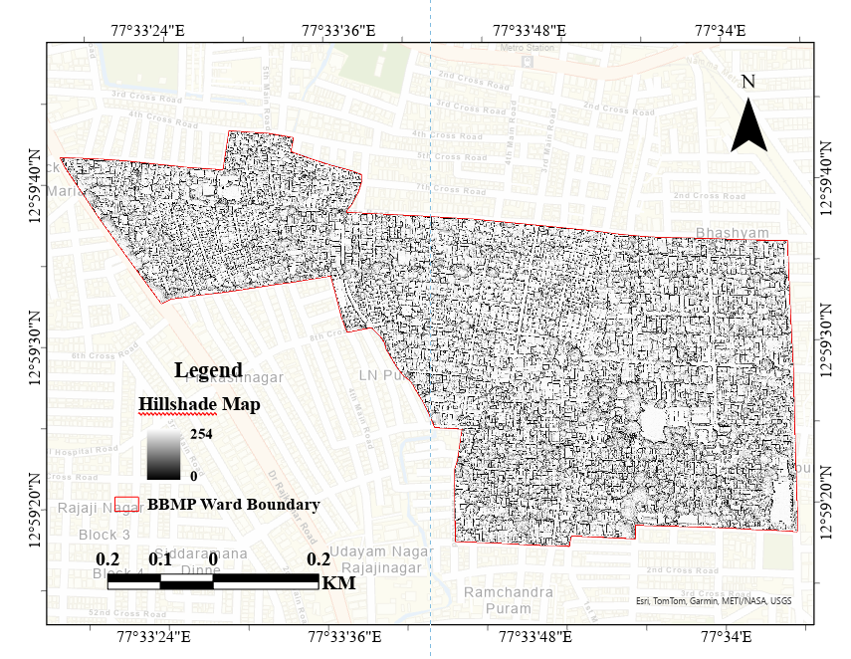
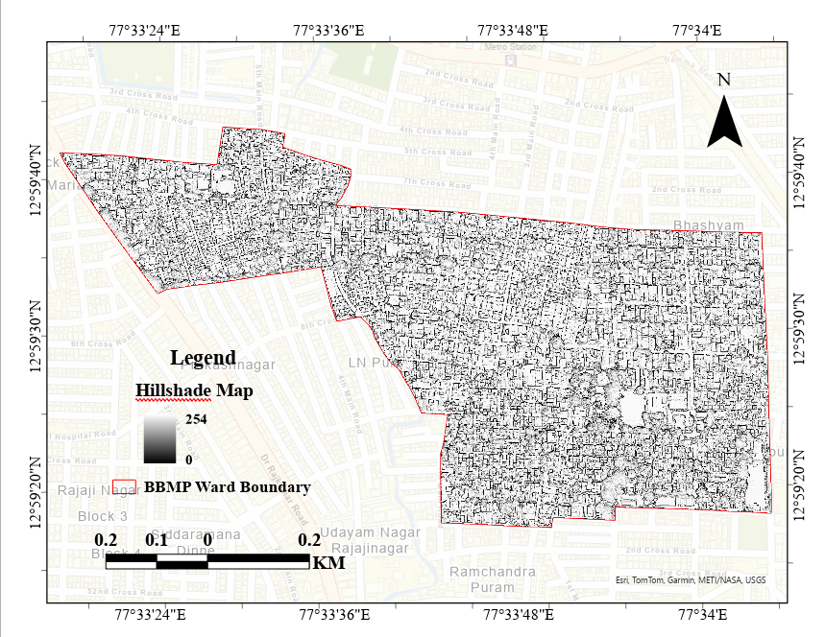
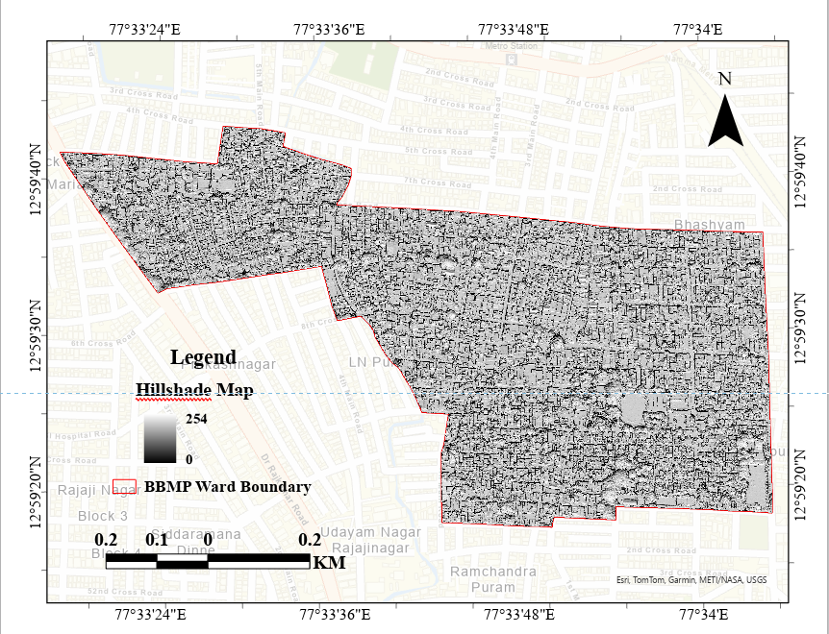
DIFFERENT HILLSHADE MAP WITH VARYING SUN ANGLE AND ELEVATION
MARCH, 21
JUNE, 21
21st March, 2025
Sun Azimuth- 151.82
Elevation- 75.26
21st June, 2025
Sun Azimuth- 204.79
Elevation- 78.41
21st September, 2025
Sun Azimuth- 166.51
Elevation-76.90
21st December, 2025
Sun Azimuth- 173.06
Elevation- 53.32
SEPTEMBER, 21
DECEMBER, 21
15

Slide 16
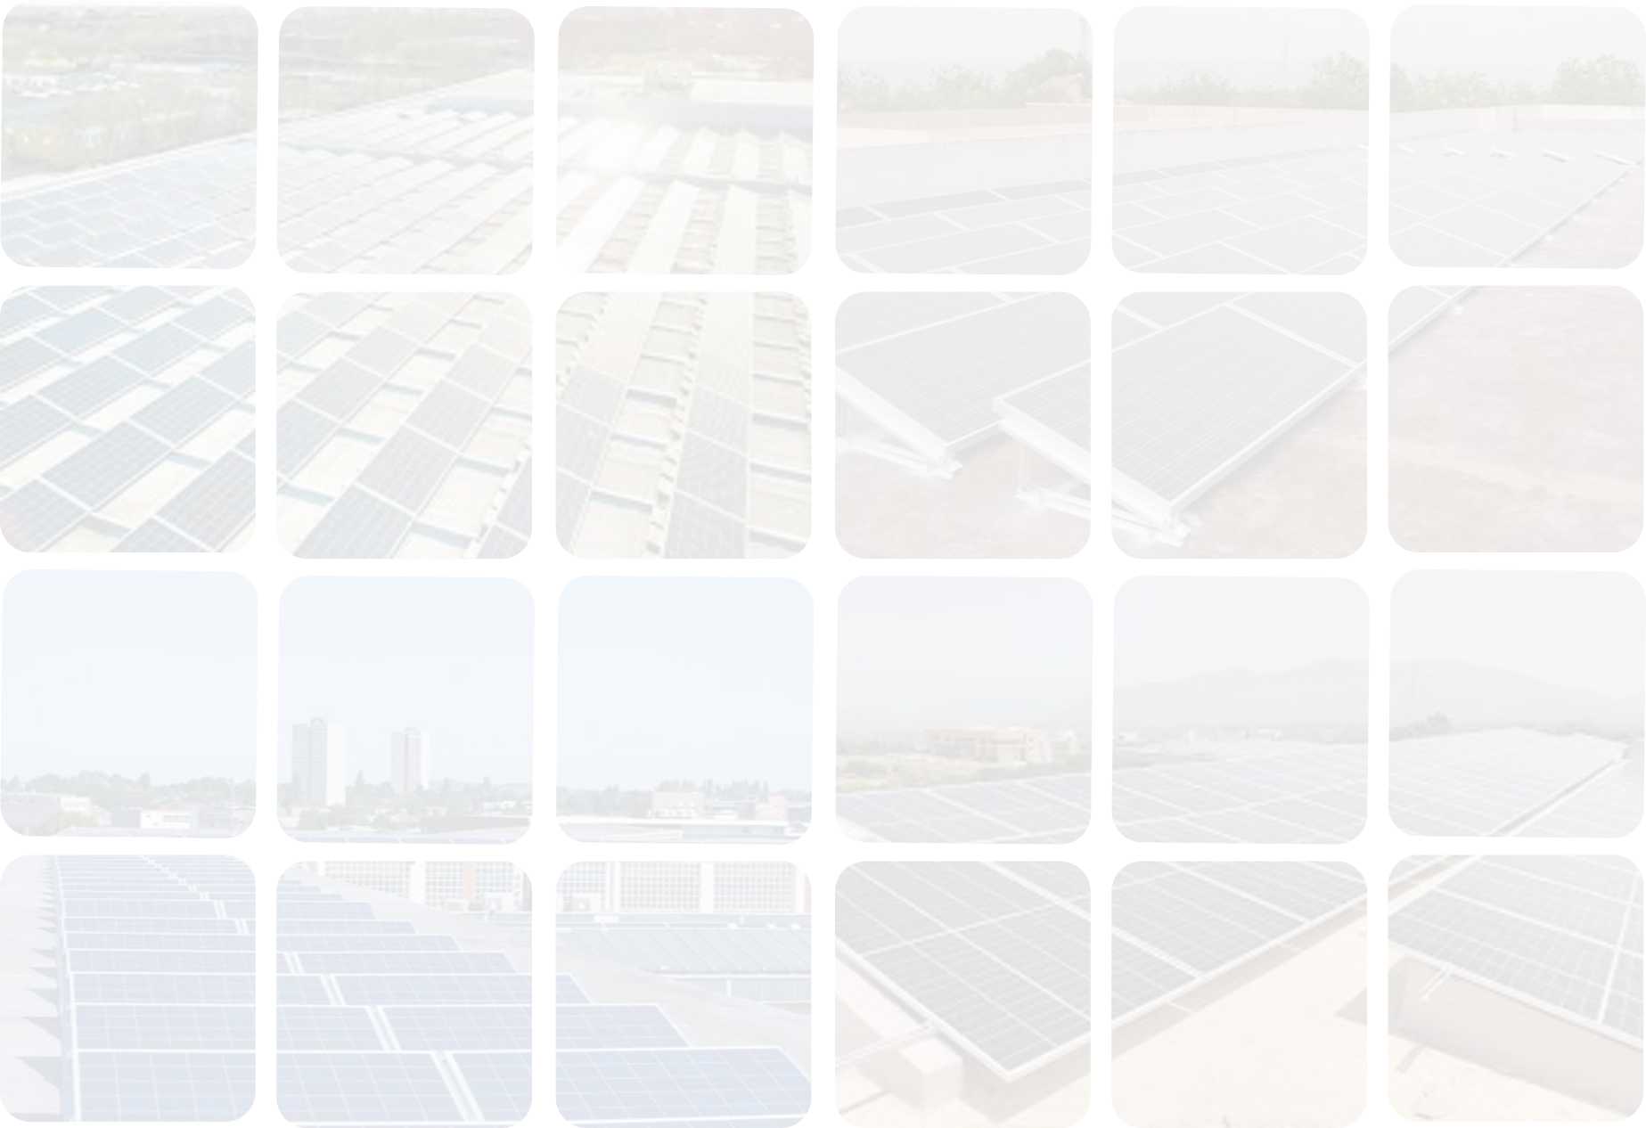



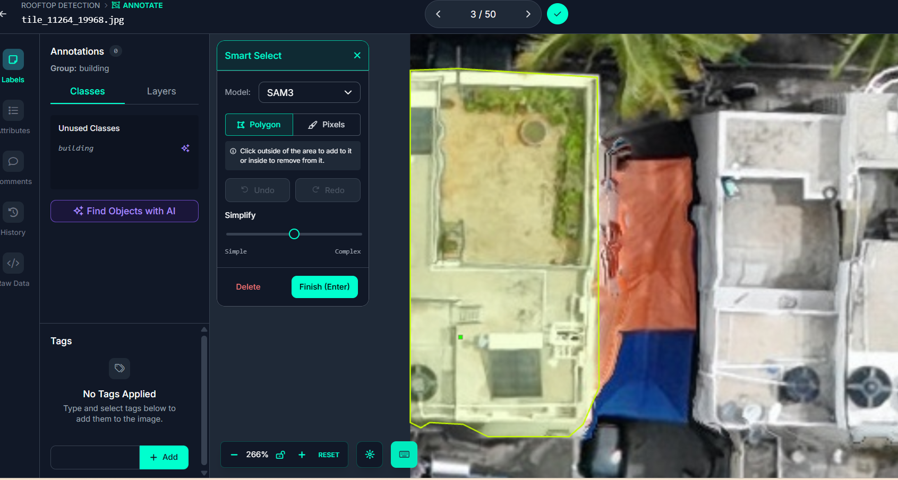


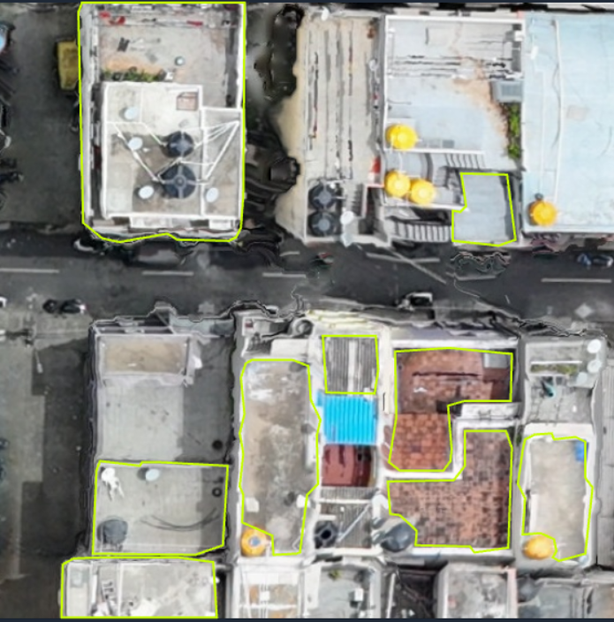



RESULT AND DISCUSSION
I
M
A
G
E
A
N
N
O
T
A
T
I
O
N
16
M A S K G E N E R A T I O N

Slide 17
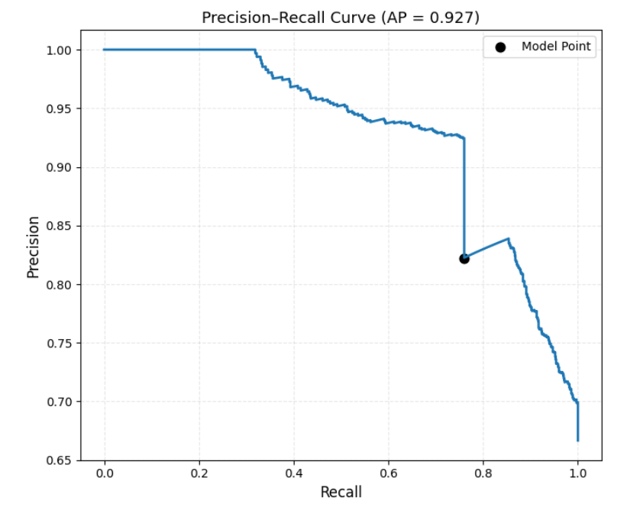
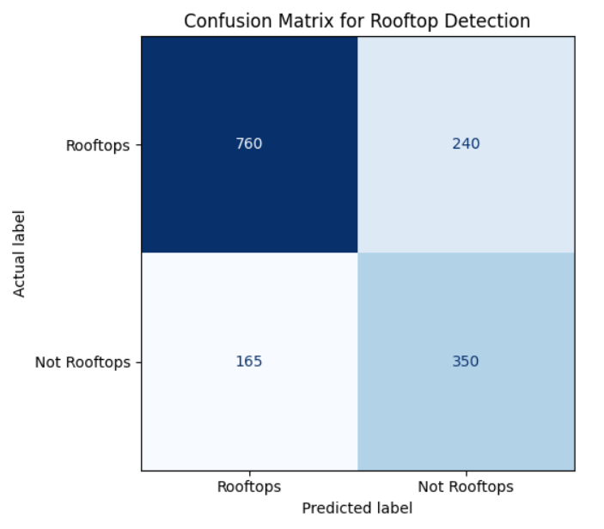
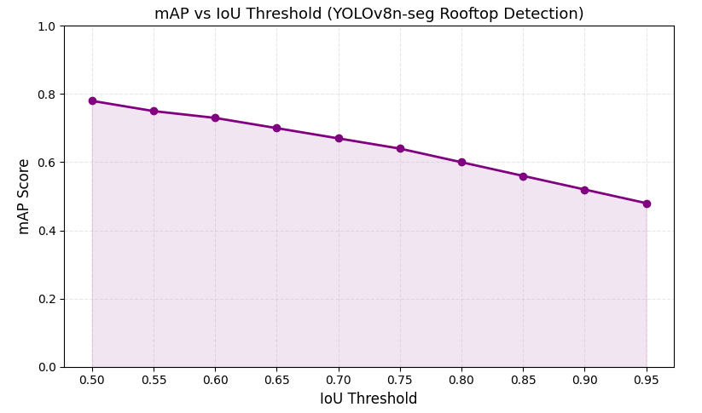
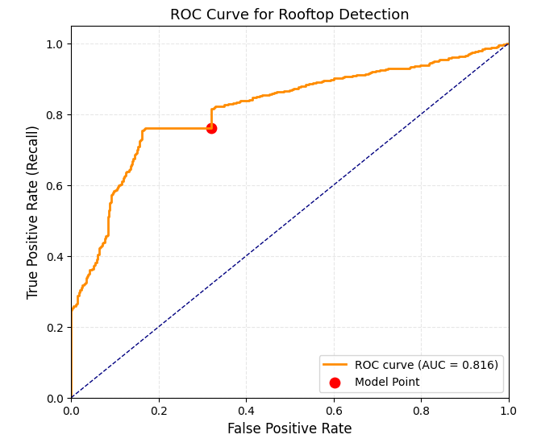
ACCURACY ASSESMENT
Precision-Recall Curve
Confusion Matrix
Precision | 0.822
Recall | 0.760
F1-Score | 0.790
Accuracy | 0.733
ROC Curve
X-axis (IoU) | Overlap threshold (0.50–0.95); higher = stricter
Y-axis (mAP) | Detection quality; higher = better
Curve Trend | Starts high (~0.78), decreases (~0.48)
Interpretation | High mAP at low IoU → good detection; lower at high IoU → precise matches harder
17

Slide 18
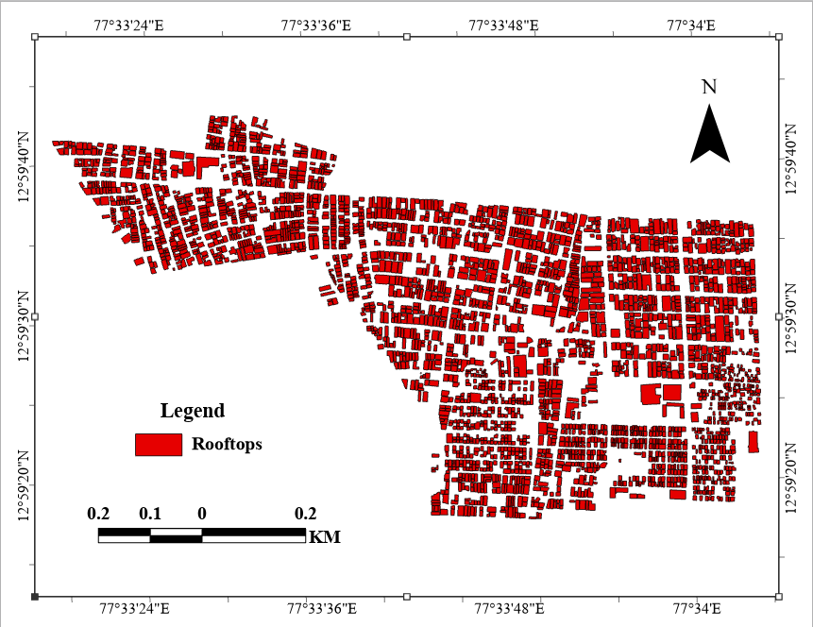
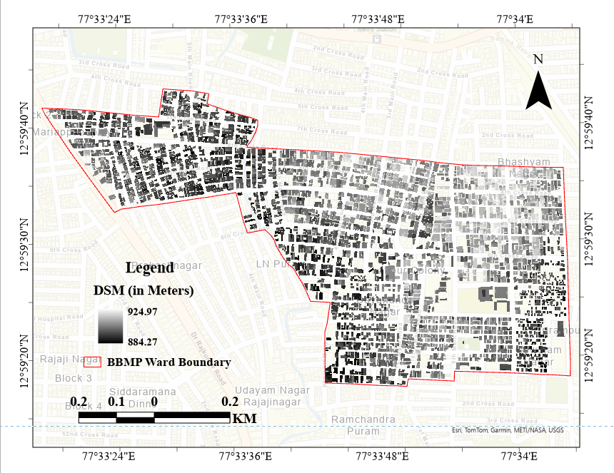
EXTRACTED VECTOR LAYER
EXTRACTED DSM
18

Slide 19
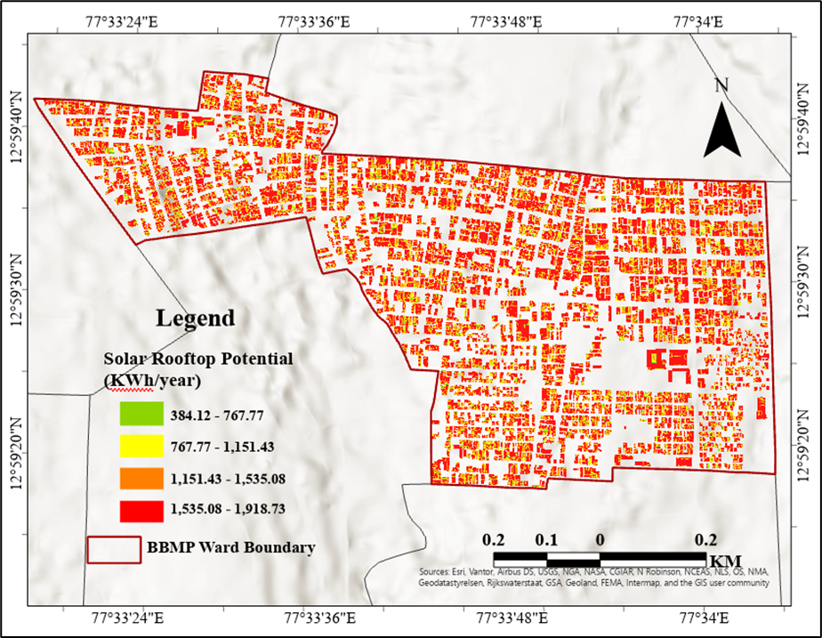
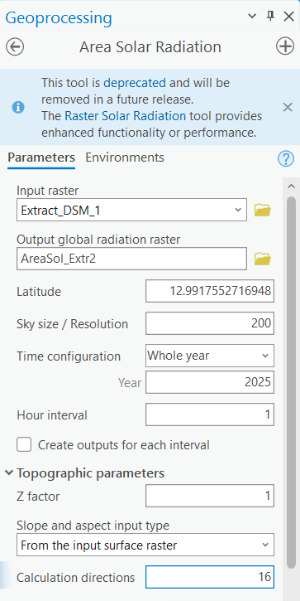
SOLAR POTENTIAL MAP
19

Slide 20
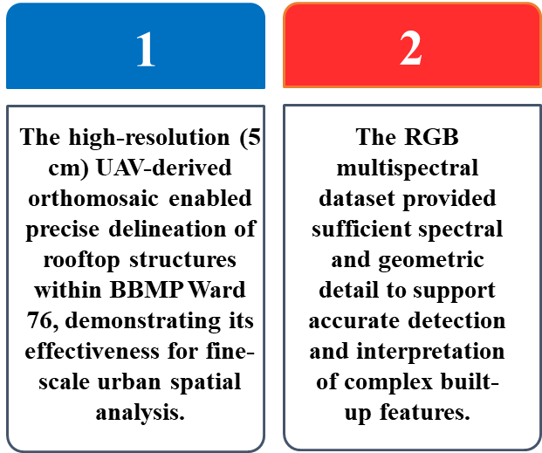
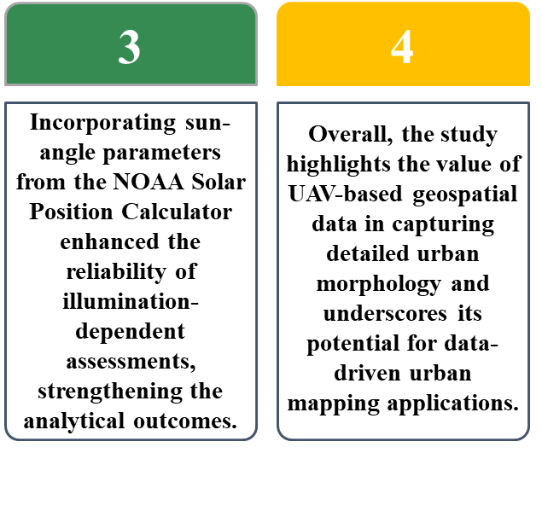
CONCLUSION
20

Slide 21
REFERENCES
International Energy Agency. (2022). World energy outlook 2022. IEA Publications.
Ministry of New and Renewable Energy. (2021). Rooftop Solar Programme Phase II: Guidelines. Government of India.
Redmon, J., Divvala, S., Girshick, R., & Farhadi, A. (2016). You only look once: Unified, real-time object detection. In Proceedings of the IEEE Conference on Computer Vision and Pattern Recognition (CVPR) (pp. 779–788).
Dhakal, S., & Shahi, R. (2022). Solar potential assessment using deep learning and GIS for smart cities. Renewable Energy, 185, 1234–1246.
Mohan, A., & Porwal, A. (2021). Deep learning-based rooftop extraction for urban solar energy mapping: A case study of Delhi. Journal of the Indian Society of Remote Sensing, 49(2), 355–366.
Zhu, X., Xia, G.-S., & Zhang, L. (2017). Object detection in remote sensing imagery using deep learning: A survey. ISPRS Journal of Photogrammetry and Remote Sensing, 130, 295–312.
21

Slide 22
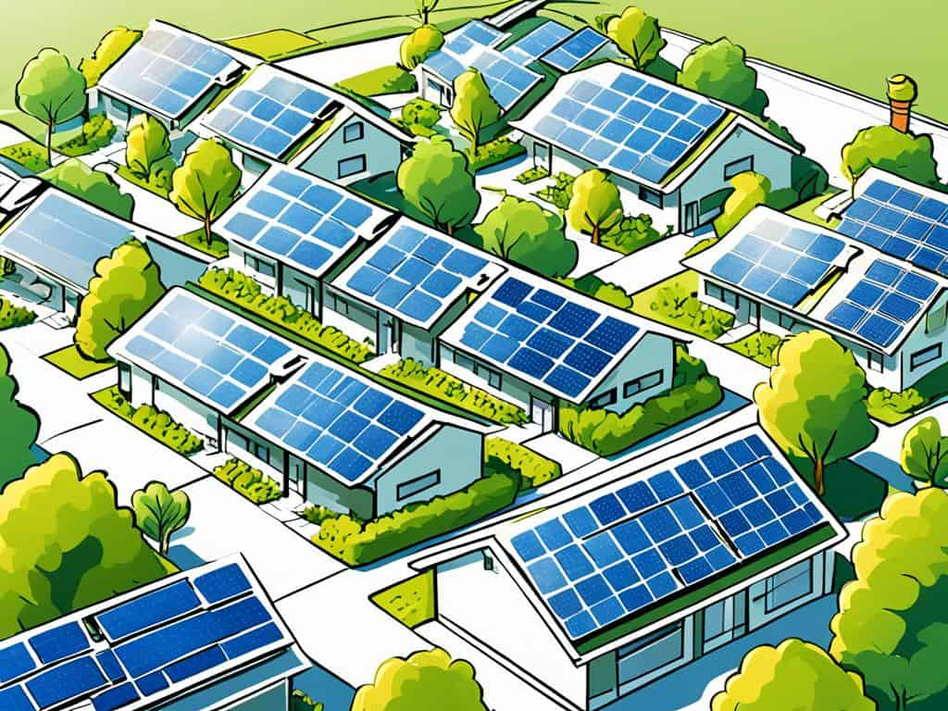
THANK YOU

